Slide 1
Waikato District Council
Representation Review 2018
Community Boards, Community Committees,
Iwi briefings, April 2018

Slide 2
Programme Overview
Welcome and introductions
Representation Review
  What is a representation review?
  What needs to be considered?
  Current arrangements
  Communities of interest
  Effective representation
  Fair representation

Slide 3
Programme Overview
  Communities and community boards
  Council workshops
  Options considered
  Preliminary community consultation
  Timetable
  Questions

Slide 4
Representation Review
What is a representation review?
  a review of a local authority’s membership and basis of election considering
    number of councillors (excluding mayor)
    how councillors are elected (wards, ‘at large’, mixture)
    if wards, number, boundaries, names, number councillors elected from each
    if communities and community boards, number, boundaries (can be subdivided), names, number members elected and appointed

Slide 5
Representation Review
  must be undertaken by all local authorities at least once every 6 years
  last undertaken by Waikato District Council in 2012 with next review in 2018
  prescribed formal process to follow under Local Electoral Act 2001

Slide 6
Representation Review
What needs to be considered?
  identify communities of interest
  how to provide effective representation to those communities of interest (number councillors, community boards etc)
  consider fairness of representation (each councillor represents about the same number of people within +/- 10%)

Slide 7
Representation Review
Current arrangements
  13 councillors
  10 wards (1-2 councillors per ward)
  30 community board members
  5 community boards (6 members per board)
  non-compliance +/-10% rule (Awaroa ki Tuakau)

Slide 8
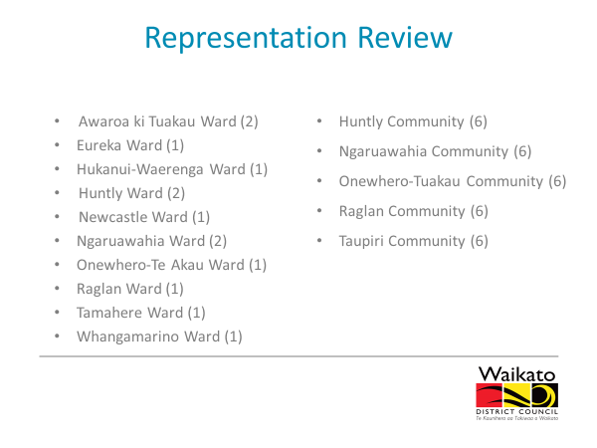
Representation Review

Slide 9
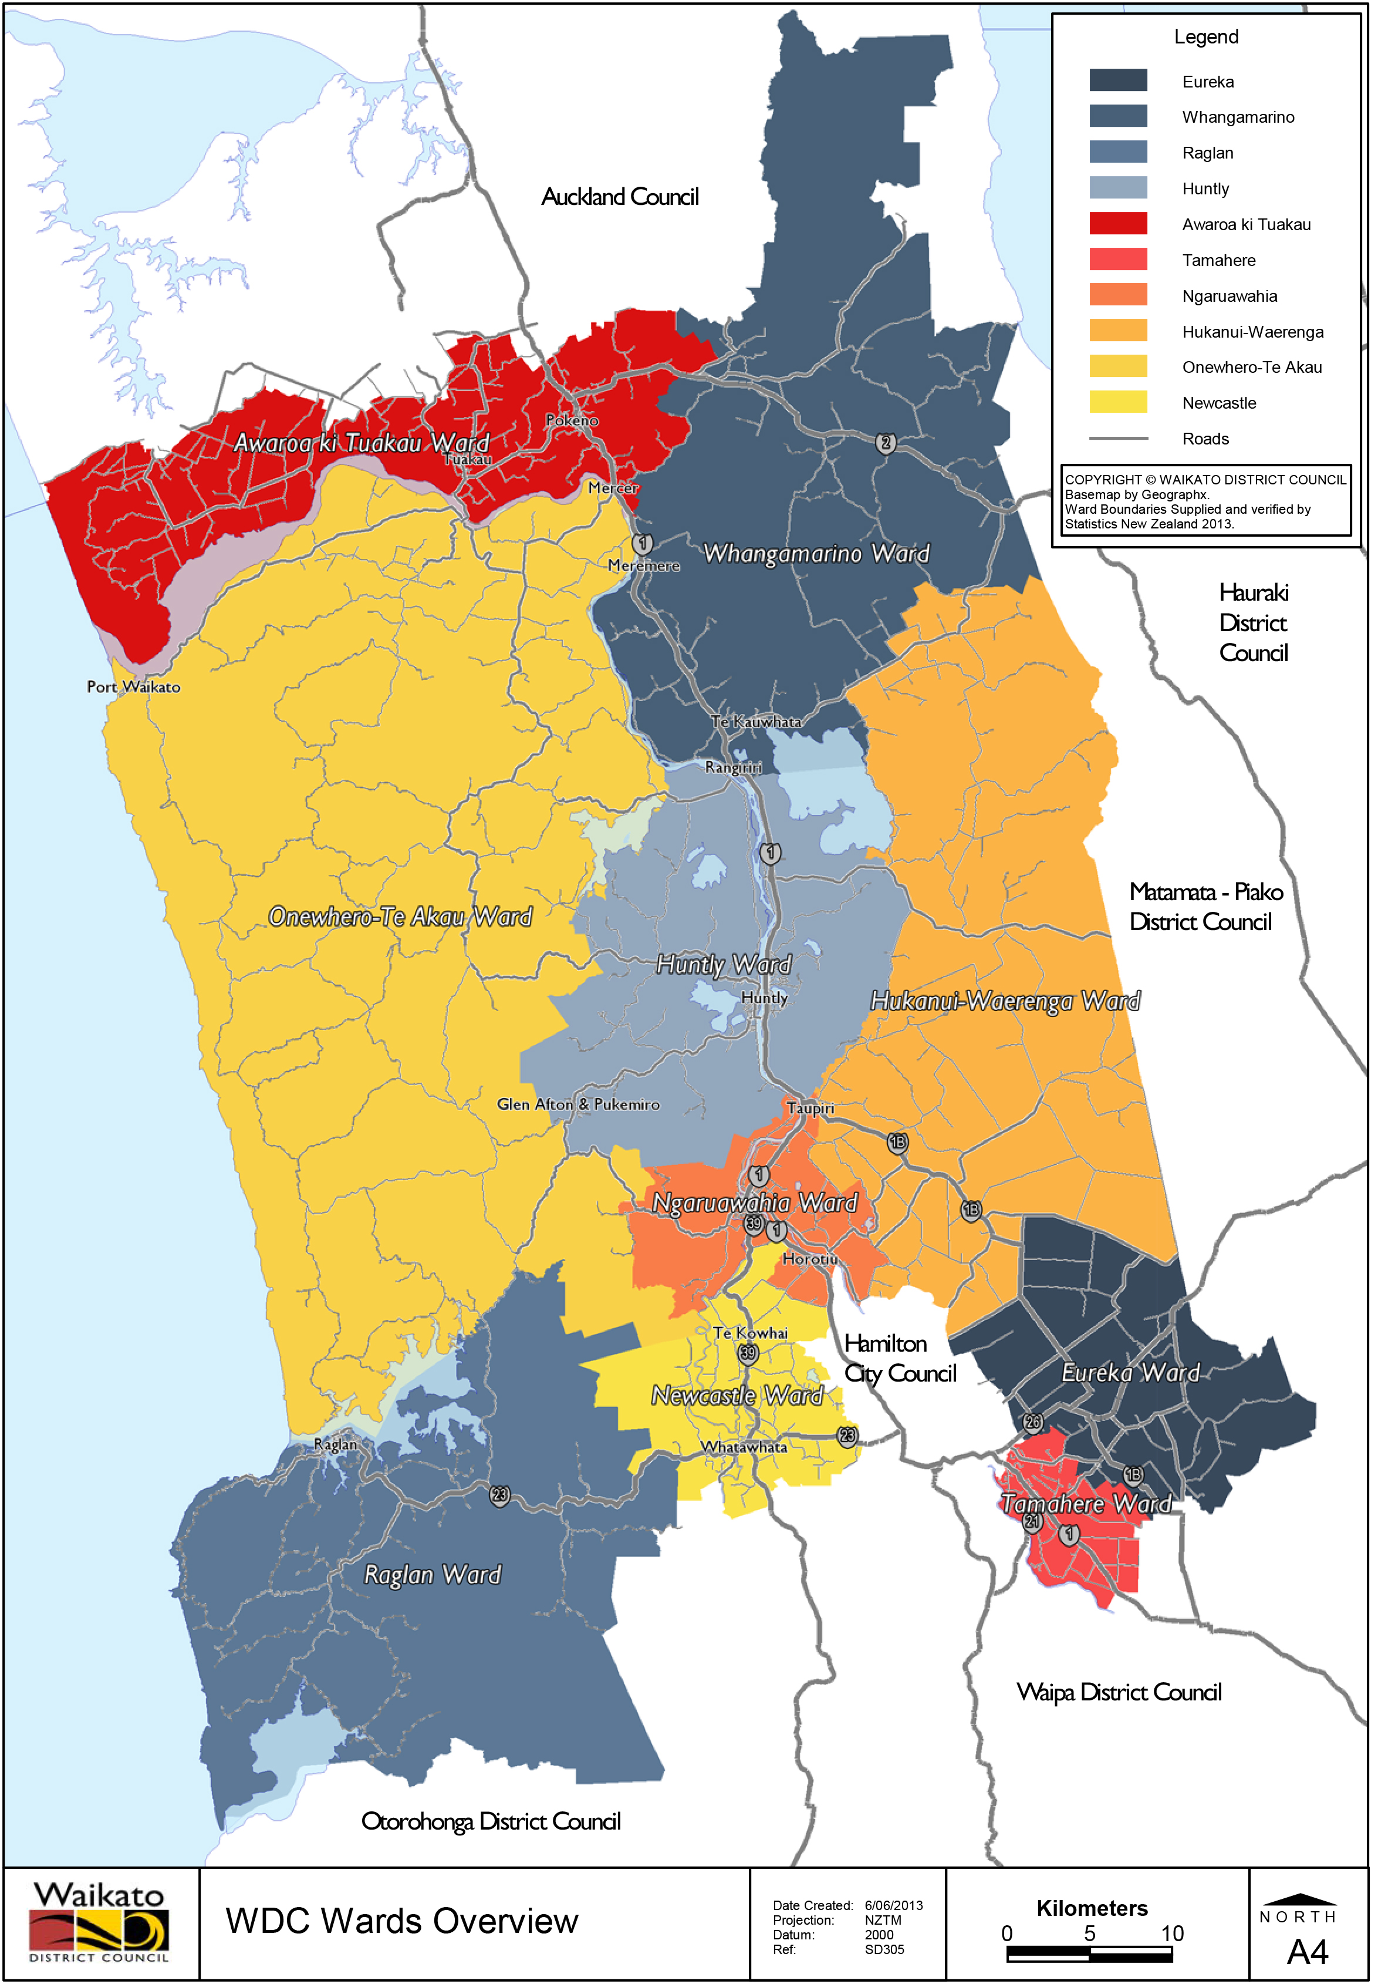

Slide 10
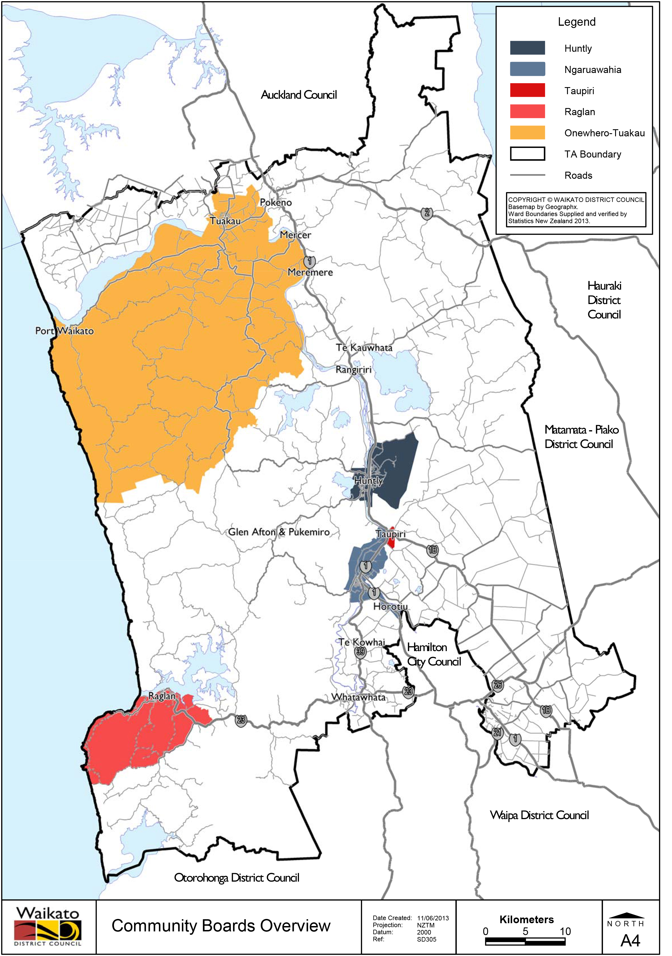

Slide 11
Representation Review
Population Statistics (Estimated Resident Population 30 June 2017)
Status quo: 73,640/13 members = 5,665 +/- 10% = 5,098 – 6,231
One ward does not comply with fair representation (+/- 10% rule)
Ward | Pop | Cnrs | Average | Fits Rule | % Variation
Awaroa ki Tuakau | 12,850 | 2 | 6,425 | No | 13.42%
Eureka | 5,600 | 1 | 5,600 | Yes | -1.14%
Hukanui-Waerenga | 5,800 | 1 | 5,800 | Yes | 2.39%
Huntly | 10,300 | 2 | 5,150 | Yes | -9.08%
Newcastle | 5,720 | 1 | 5,720 | Yes | 0.98%
Ngaruawahia | 10,400 | 2 | 5,200 | Yes | -8.20%
Onewhero-Te Akau | 5,400 | 1 | 5,400 | Yes | -4.67%
Raglan | 5,790 | 1 | 5,790 | Yes | 2.21%
Tamahere | 5,650 | 1 | 5,650 | Yes | -0.26%
Whangamarino | 6,130 | 1 | 6,130 | Yes | 8.22%

Slide 12
Representation Review
Communities of Interest
  not defined in legislation
  may mean different things to different people
  LGC definition describes it a three-dimensional concept
      perceptual – a sense of belonging to a clearly defined area or locality
      functional – meet with reasonable economy the community’s requirements for physical and human resources
      political – elected body to represent the interests of all its members

Slide 13
Representation Review
    area where one feels sense of community and belonging
    access to daily goods and services
    rohe of local iwi and hapuu
    dependence on shared facilities (schools, shops)
    physical and topographical features may impact
    can change over time (eg Pokeno)

Slide 14
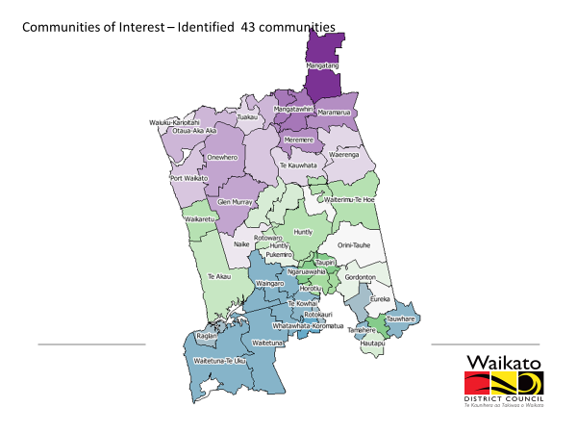

Slide 15
Representation Review
  Effective Representation
    consider how communities of interest are most effectively represented
      total number of elected members
      elected members elected from wards/’at large’/mix
      ward names, boundaries
      communities and community boards (retain, alter, disestablish, number, names, boundaries, membership, subdivisions)

Slide 16
Representation Review
  Fair representation
    population equity (+/- 10% of average)
    generally means each elected member represents about same number of people (within +/-10%)
    one ward does not comply

Slide 17
Representation Review
Communities and community boards
    retain, expand, amalgamate, abolish, subdivide?
    what is the best number of elected and appointed members?
    boundaries, names?
    if subdivided, parts must comply +/- 10%
    feedback from community boards and community committees

Slide 18
Representation Review
Council workshops
  19 June 2017
    overview of upcoming processes
      electoral system (by 12 September 2017)
      Māori wards (by 23 November 2017)
      representation review (from 1 March 2018)
    representation review criteria
      communities of interest, effective and fair representation
    complex, legislative compliance
    community engagement
    timetable
Notes:
.

Slide 19
Representation Review
  21 March 2018
    FPP electoral system confirmed
    presentation to Waikato Tainui (19 July 2017)
    no to establishing Māori wards (13 November 2017)
    communities of interest explored (43 communities)
    effective representation discussed
      number councillors, elected by wards/’at large’/mixture
    fair representation (one ward not comply +/- 10%)
    community boards
      retain, expand, amalgamate, abolish, subdivide
Notes:
.

Slide 20
Representation Review
Options considered
    Option 1: Status quo
      13 councillors, 10 wards, 30 community board members, 5 community boards, not complies +/- 10% rule
    Option 2: Modified status quo
      13 councillors, 10 wards, 30 community board members, 4 community boards, complies +/- 10% rule
    Option 3: Reduced wards, matching community boards
      13 councillors, 5 wards (north-south combinations), 30 community board members, 5 matching community boards, complies +/- 10% rule
Notes:
.

Slide 21
Representation Review
    Option 4: Reduced councillors and wards, matching community boards
      11 councillors, 3 wards (north/central/south), 18 community board members, 3 matching community boards, complies +/- 10% rule
    Option 5: Mixed wards/at large
      further investigation required
    Option 6: At large
      further investigation required
Notes:
.

Slide 22
Representation Review
  initial feedback from councillors
    retain 13 councillors and 10 wards
    investigate minimum changes
      make Awaroa ki Tuakau Ward comply +/- 10% rule (around Mercer area)
    reconfigure Onewhero-Tuakau Community Board
      Tuakau Community Board (north of river)
      balance (south of river) make a community committee
Notes:
.

Slide 23
Representation Review
    seek views of Pokeno Community Committee
      potential Pokeno Community Board or
      part of new Tuakau-Pokeno Community Board
    investigate merging Taupiri Community Board with expanded (Horotiu) Ngaruawahia Community Board
      possible subdividing into three
    investigate expanding current Raglan Community Board to match ward boundary
    seek community board, community committee and iwi informal feedback
Notes:
.

Slide 24
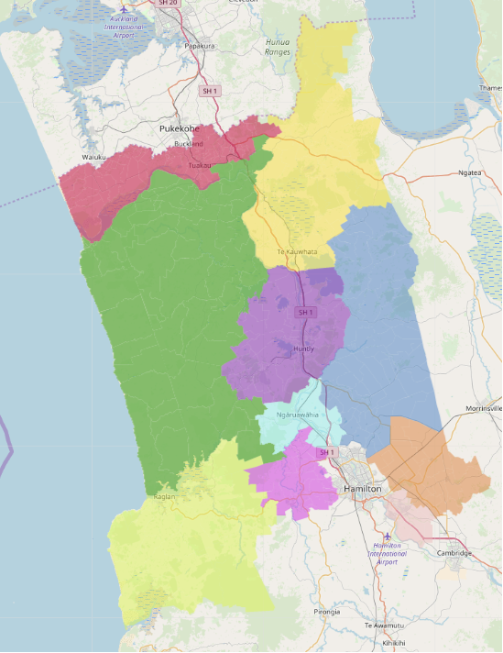
Representation Review - Option 2
    Add map (modified status quo)
Notes:
.

Slide 25
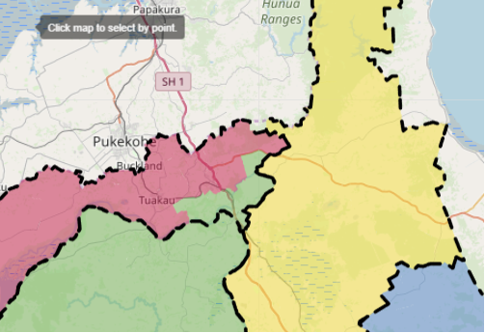
Representation Review - Option 2
    Add map (modified status quo)
Notes:
.

Slide 26
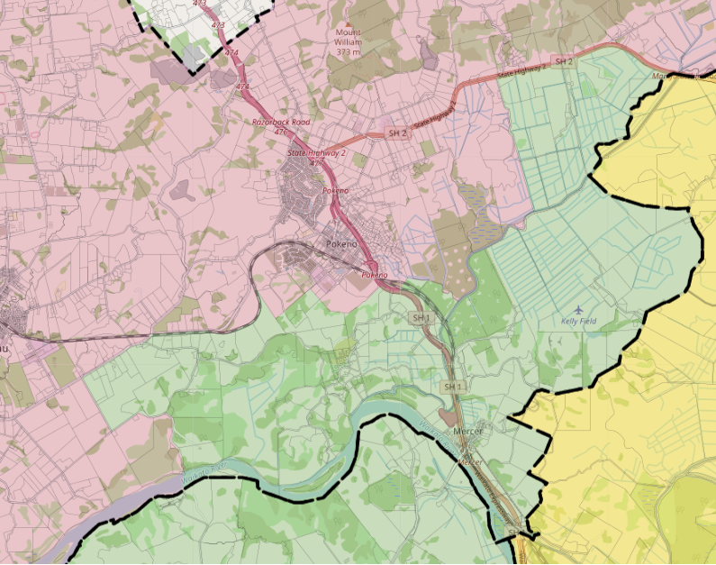
Representation Review - Option 2
    Add map (modified status quo)
Notes:
.

Slide 27
Representation Review – Option 2
Population Statistics (Estimated Resident Population 30 June 2017)
Status quo: 73,640/13 members = 5,665 +/- 10% = 5,098 – 6,231
Wards comply with fair representation (+/- 10% rule)
*Subject to confirmation by Department of Statistics
Ward | Pop | Cnrs | Average | Fits Rule | % Variation
Awaroa ki Tuakau | 12, 462* | 2 | 6,231 | Yes | +10%
Eureka | 5,600 | 1 | 5,600 | Yes | -1.14%
Hukanui-Waerenga | 5,800 | 1 | 5,800 | Yes | ‘+2.39%
Huntly | 10,300 | 2 | 5,150 | Yes | -9.08%
Newcastle | 5,720 | 1 | 5,720 | Yes | +0.98%
Ngaruawahia | 10,400 | 2 | 5,200 | Yes | -8.20%
Onewhero-Te Akau | 5, 788* | 1 | 5, 788 | Yes | -4.27%
Raglan | 5,790 | 1 | 5,790 | Yes | +2.21%
Tamahere | 5,650 | 1 | 5,650 | Yes | -0.26%
Whangamarino | 6,130 | 1 | 6,130 | Yes | +8.22%

Slide 28
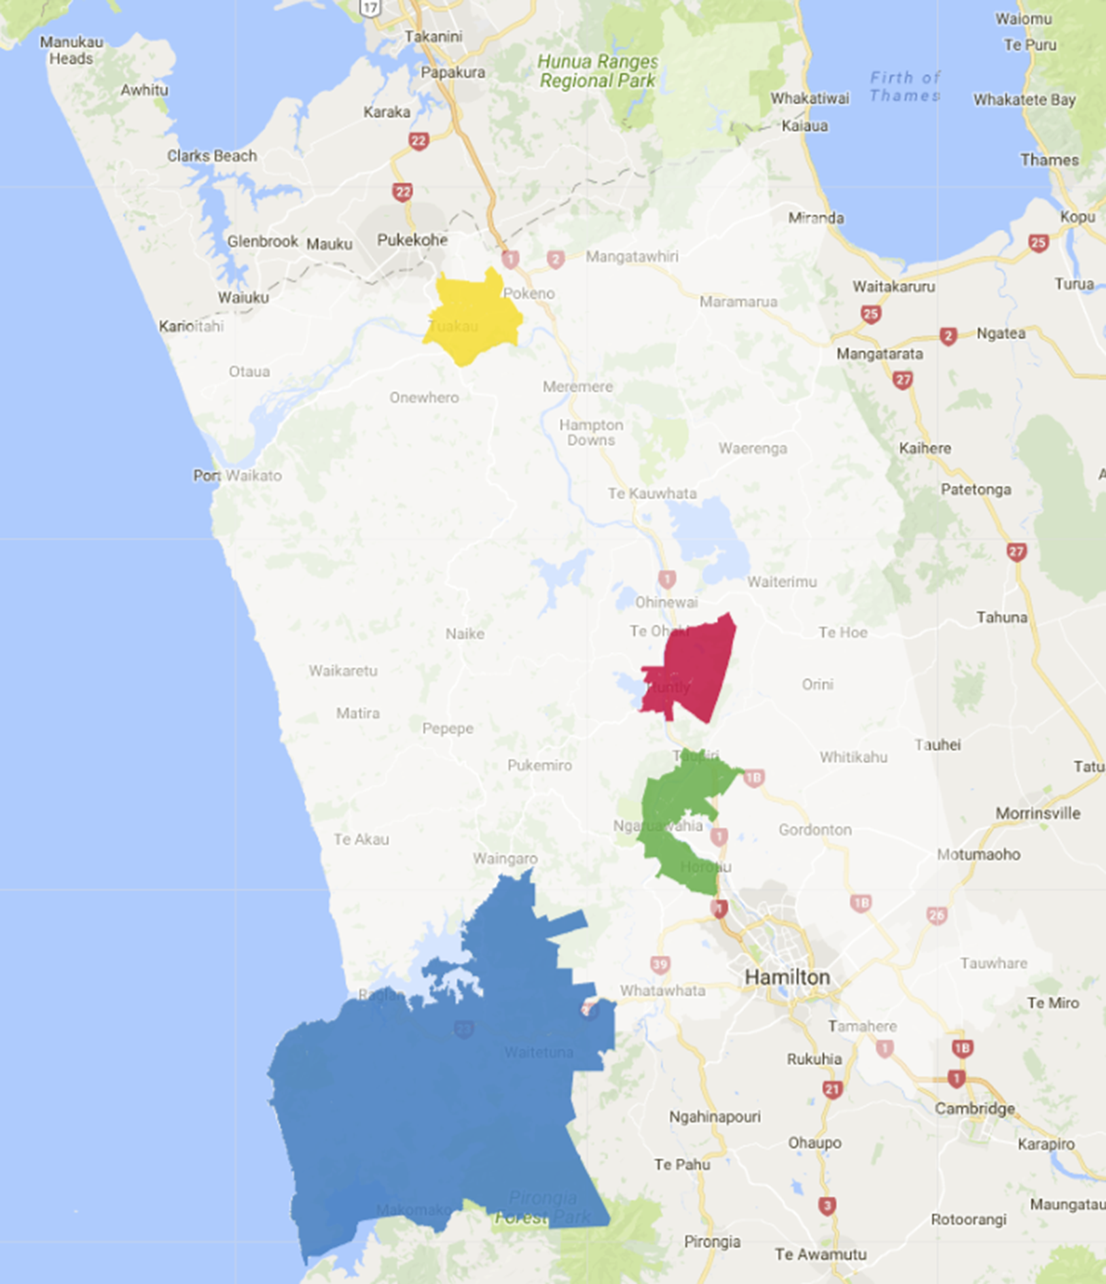
Representation Review – Option 2
    Add map (modified status quo)
Notes:
.

Slide 29
Representation Review
Preliminary community consultation
    community board and community committee meetings
      Raglan, 2pm 23 April
      Tamahere, 6pm 23 April
      Tuakau, 6pm 24 April
      Ngaruawahia, 6pm 26 April
    iwi hui
      Ngaruawahia, 11am 27 April

Slide 30
Representation Review
Preliminary community consultation
    Survey Monkey questions
      Which ward do you currently associate most closely with? (wards listed)
      How many councillors (excluding the mayor) do you think is a good number
      (5-7, 8-10, 11-13, 14-15, 16-20, 20+)
      How do you think we should elect our councillors (excluding the mayor)?
      ward/’at large’/mixture
      Which community board do you currently associate with?
      (boards listed)

Slide 31
Representation Review
      Should the current community boards be retained?
      (boards listed)
      Should new community boards be established?
      Are there any other comments to help informa Council’s proposal?
    survey to run 16 April to 5pm, 4 May
    survey responses provided to councillors for consideration at next workshop 15 May 2018
    formal consultation June – September 2018

Slide 32
Timetable
    Council Workshop 1 19 June 2017
    Council Workshop 2 21 March 2018
    Informal consultation 16 April – 4 May 2018
      community boards/committees 23-26 April
      iwi 27 April
    Council Workshop 3 15 May 2018
    Council meeting (initial proposal) 11 June 2018
    Public notice 20 June 2018
    Submission period 20 June – 1 August 2018

Slide 33
Timetable
    Hearings 14 – 31 August 2018
    Council meeting (final proposal) 10 September 2018
    Public notice 12 September 2018
    Appeal/objection period 12 Sept – 12 Oct 2018
    Forward material to LGC 30 October 2018
    LGC decision by 10 April 2019

Slide 34
    Questions?

Slide 35
Waikato District Council
Representation Review 2018
Community Boards, Community Committees,
Iwi briefings, April 2018

